Slide 1




Cryptographic protocol analysis and verification
Project Sponsor: Ed Zieglar
TEAM ARMORWARE:
Mostafa Galib
Aj Shah
Sreevidhya Ravindran
Major Liu
Zoraida Vences

Slide 2
PROJECT DESCRIPTION:
What protocol are we analyzing?
We will be analyzing the security properties of 5G-EAP-TLS authentication protocol
5G network is the next generation of mobile network
We will use Cryptographic Protocol Shapes Analyzer (CPSA) to model and analyze the 5G-EAP-TLS protocol

Slide 3
A brief overview of 5g:
According to the 3GPP specification, the 5G network architecture can be categorized into these three categories:
User Equipment (UE), which is comprised of these four elements
  Subscription Permanent Identifier (SUPI), which is a unique and permanent subscriber identity
  Public key of the home network
  A long-term secret symmetric key, shared between the subscribers and their corresponding home network
  Sequence Number
Serving Network (SN) which acts as a middleware during the authentication process
Home Network (HN) which is responsible for user authentication and which contains the following elements
  Authentication Server Function (AUSF), which performs authentication with the UE
  Unified Data Management (UDM) to assist in functions related to data management

Slide 4
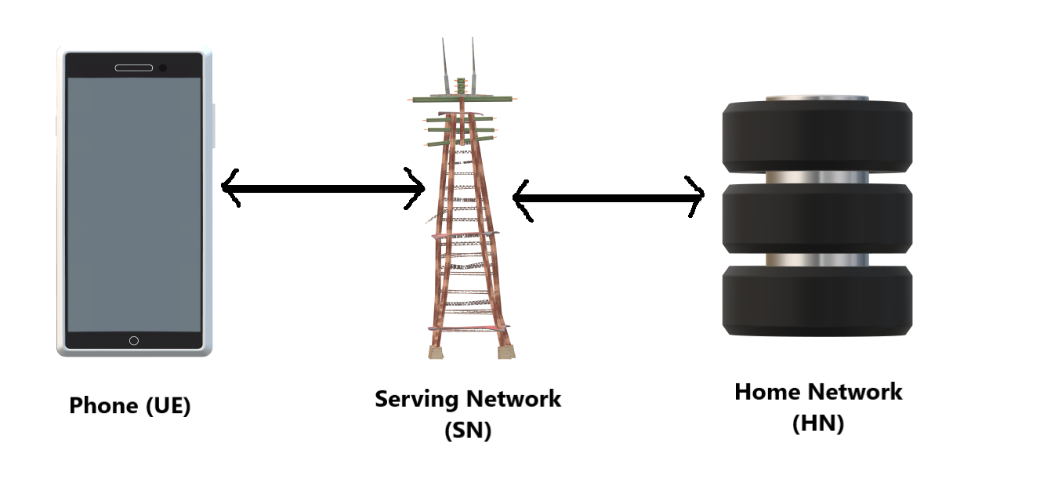
A Simple architecture diagram of 5g:

Slide 5
Formal verification of 5g-eap-tls protocol - I
Modeling Choice
We will consider two roles: UE and network NW (a composition of Serving Network and Home Network)
  Since serving network and home network communicate through wired connection, we are combining them into one network as wired connection is assumed to be secured
We will model the protocol according to the Dolev-Yao model, which is:
  Cryptography is assumed to be perfect, which is a message can only be decrypted by someone who has the right key
  Messages are assumed to be abstract terms, i.e. either the intruder learns the complete message because of having the key, or the intruder learns nothing at all
  Network is assumed to be under full control of the intruder

Slide 6
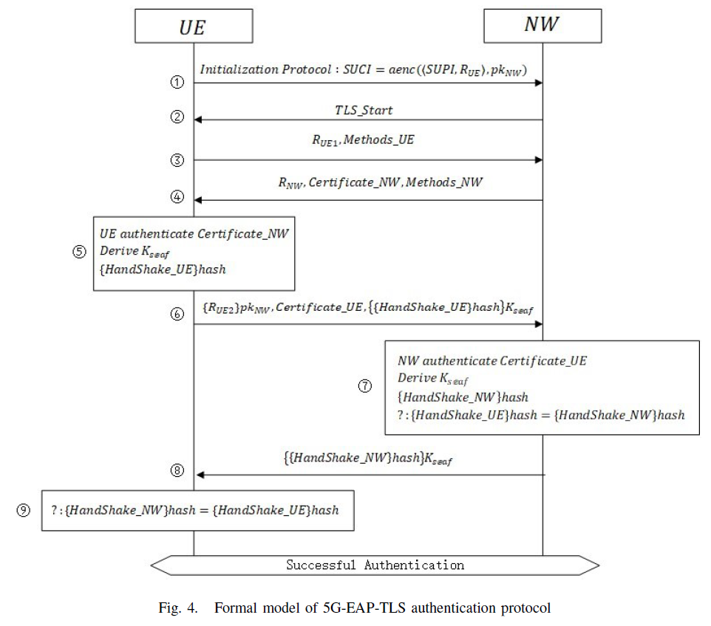
Formal verification of 5g-eap-tls protocol - II
Formal Model Diagram of 5G-EAP-TLS protocol

Slide 7
Formal verification of 5g-eap-tls protocol - III
Formal Model
UE generates a nonce, N_{UE1} and encrypts SUPI, N_{UE1} with the public key of NW to send the data to NW
NW replies with TLS-Start message to indicate the initiation of the TLS process
UE generates another nonce, N_{UE2} and sends it to NW together with a constant string Method-UE to indicate the method of calculation for the authentication process
NW generates a nonce N_{NW} and sends it to UE along with NW’s certificate and a constant string Method-NW to indicate the authentication method
UE authenticates the certificate of NW and upon successful authentication:
  UE generates a new nonce N_{UE3} and computes the session key from N_{UE2}, N_{NW} and N_{UE3}
  UE sends N_{UE3} encrypted with the public key of NW along with UE’s certificate and hash of Handshake-UE string which is encrypted with the session key
NW authenticates the certificate of UE and upon successful authentication:
  NW computes the session key in the same way as UE did
  NW calculates the hash of Handshake-NW and if it is equal to the hash of Handshake-UE, then it claims the authentication to be successful and proceeds to the next step
NW sends the hash of Handshake-NW string encrypted with the session key to UE
UE compares the hash of Handshake-NW to the hash of Handshake-UE, and if they are equal, then it claims the authentication to be successful

Slide 8
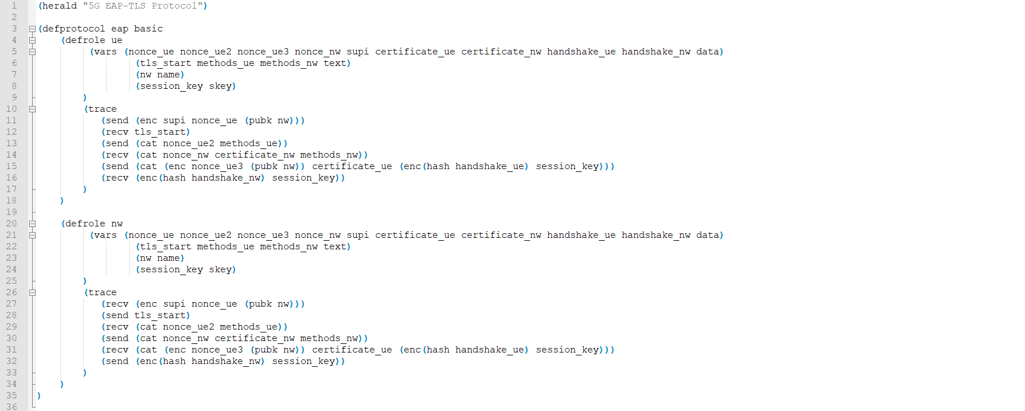
5G-EAP-TLS Model in cpsa - I

Slide 9
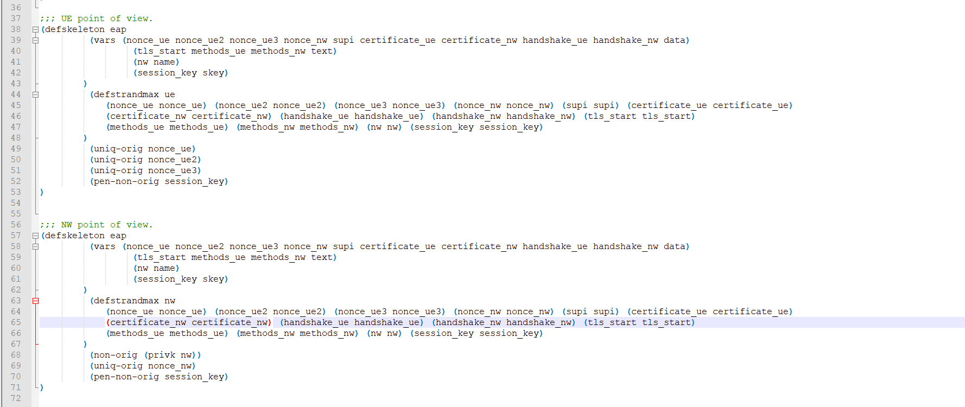
5G-EAP-TLS Model in cpsa - II

Slide 10
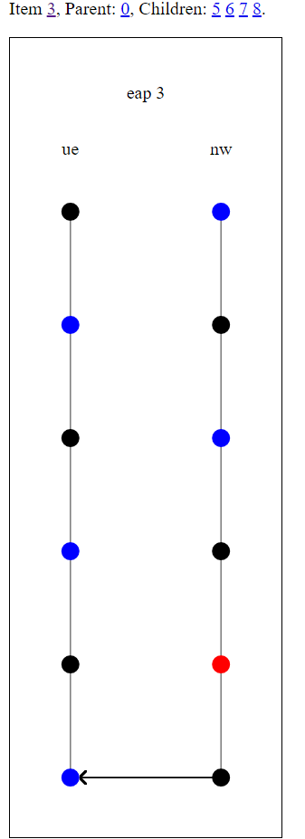
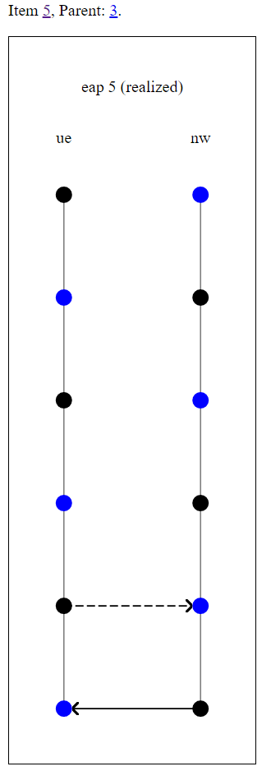
Few sample Shapes generated by cpsa

Slide 11
Thank you!
Any QUESTIONS?

